Slide 1
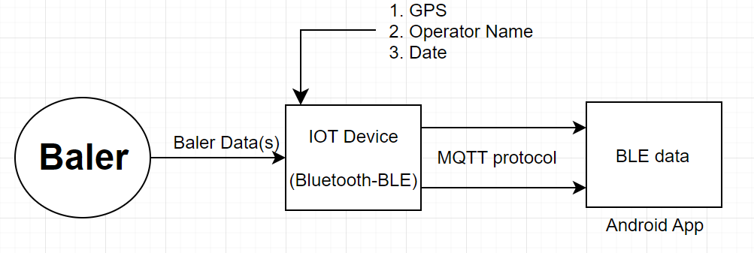
Baler Project
The purpose of this project is to access the details of Bales through a mobile application. A Bale is a large closely pressed package of hay/grass. We have to send details about this bale/bales using an Adafruit Feather Express microcontroller and the nRF52840 transceiver which will be supporting the system for Bluetooth LE. Through nRF connect application, the data will be visible to the user. The data has to be saved in the internal EEPROM of the Adafruit Feather Express. An Interrupt has to be implemented to receive the BLE UART characteristic UUID, and again, another interrupt has to be sent to receive the weight of each Bale through hx711 module. Through MQTT protocol the IoT device should be communicating to the android app in order to receive the data from cloud and then transmitting it to the mobile application.
The details to be sent on the user app are:
GPS
Number of Bale(s)
Weight of each bale
Operator’s Name
Date
Refer to the block diagram below for the execution process.
Pratyusha Jha

